Slide 1
ACMA 231
Intro to Excel

Slide 2
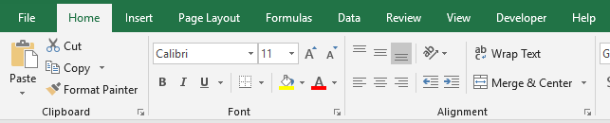
Intro to Excel ~ Tabs
File – saving, printing, options
Home – formatting and editing commands
Insert – tables, charts, & graphs
Page Layout – headers, footers, print formats
Formulas – directory of formulas
Data – importing data, filtering, sorting, limitations
Review – proofing, commenting, protections
View – spreadsheet or multi-file viewing options
Developer – VBA and macros portal

Slide 3
Intro to Excel ~ Tabs
Enable “Developer” tab in Excel
Windows version:
  Click the “File” button on the top left corner on Excel
  On the bottom left corner, select “Options”
  From the menu that shows up, select “Customize Ribbon”
  Check the box of “Developer” tab in the right column
Mac version:
  Click the “Excel” tab at the top of the screen
  Choose the “Preferences” option
  Select the “Ribbon & Toolbar” option
  Check the box to the left of “Developer” in the right column
  Click the “Save” button at the bottom-right corner of the window

Slide 4
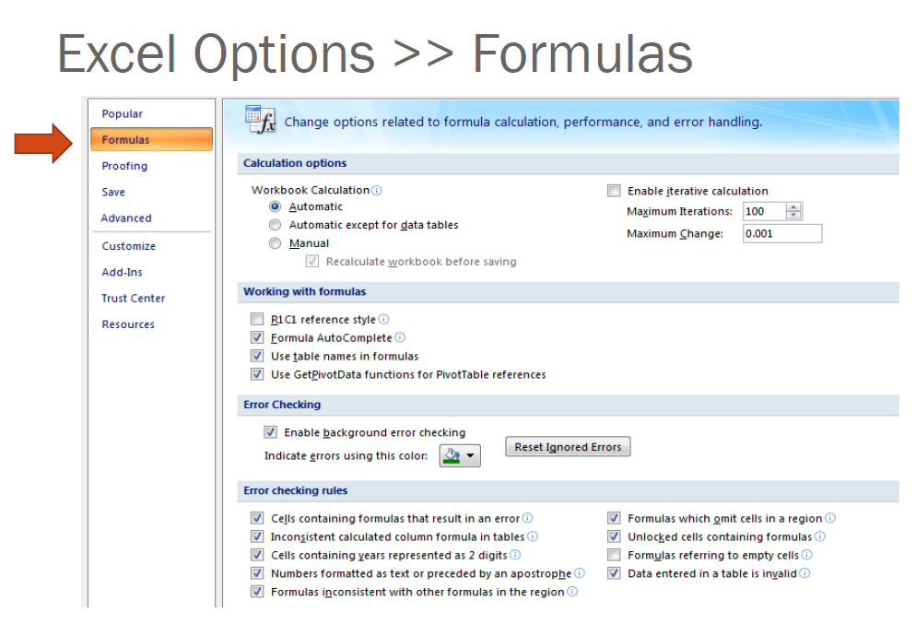
Intro to Excel ~ Options setup

Slide 5
Intro to Excel ~ Keyboard Shortcuts
Practice these! Know these! Use these!
A full list of keyboard shortcuts can be found here:
https://support.office.com/en-us/article/Excel-shortcut-and-function-keys-1798d9d5-842a-42b8-9c99-9b7213f0040f

Slide 6
ACMA 231
Excel:
Functions Part 1

Slide 7
Excel: Functions Part 1 ~ hiding/unhiding columns, rows, and & sheets
Hiding columns:
Highlight the column(s) you want to hide
Right-click and select “Hide”
Unhiding columns:
Locate the hidden column(s) by finding the lightly colored line where the hidden column(s) would be on the column index bar
Highlight the columns before to after the lightly colored line
Right-click and select “Unhide”
Hiding/unhiding rows:
Apply similar instructions for rows as given above for columns
Hiding Worksheets:
Click on the worksheet tab that you would like to hide
  Note: to hide more than one worksheet at a time, hold down Ctrl as you select the tabs with your mouse
Right-click and select “Hide”
Unhiding Worksheets:
Right-click on any worksheet tab
When the Unhide Worksheet window pops up, select the desired worksheet to unhide and click OK.

Slide 8
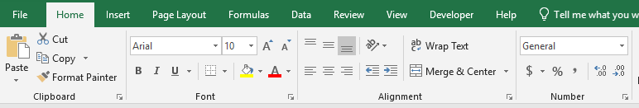

Excel: Functions Part 1 ~ creating simple formulas & formatting
Creating simple formulas:
In the desired cell, simply write = followed by the formula. For example to add the values of cells D2 and D3 into D4, simply write a formula in D4: = D2 + D3
Formatting:
Text formatting
e.g. Bold, Italics,
Underlined,
Font type and size
Color of cell(s) and font colors
Merge several cells into one and center the alignment of the text.
Wrapping the text makes it so that multiple lines of text will stay visible
Number formats
e.g. dollar, percentage, dates, number of decimal places displayed, etc.
Alignment of text within cells
Cell(s) border style
Clicking once will copy the format of cells into others.
Clicking twice will allow you to copy the format of cells into many others many times until you push Esc.

Slide 9
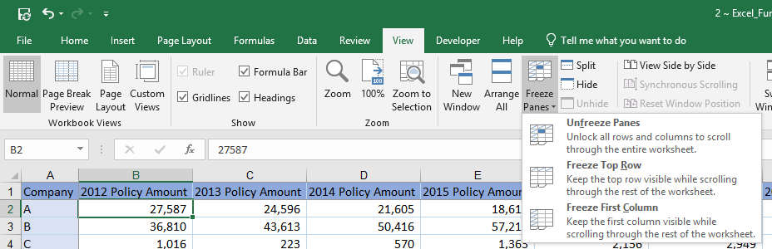
Excel: Functions Part 1 ~ freeze/lock certain rows and/or columns for viewing
Super useful when looking at numerous rows or columns and you want to still see the index and/or headers.
Select the cell that represents the top left of the section you want to be “movable”
Go to the View tab in the ribbon and select Freeze Panes
Select the type of freezing you want. For example, if you want the column headers to stay, but you want the rows to be fluid, select Freeze Top Row, or if you have selected cell A2, you can just select Freeze Panes
To unfreeze panes, go the View tab and select Unfreeze Panes

Slide 10

Excel: Functions Part 1 ~ "Copy & Paste" vs "Fill"
Copy Paste
Cut Paste
Fill: update numerous cells at once using either Ctrl+d or Ctrl+r or you can double-click or drag the little square at the bottom right corner of the cell

Slide 11
Excel: Functions Part 1 ~ Cell reference - LOCAL vs ABSOLUTE
C3
Column Row
When copy/cut/paste or filling, we may want the column and/or row to stay the same for the new cell location. We can “lock” our references so that this can happen:
$C$3 “Absolute” reference – i.e. the reference will always be C3
C$3 The row is locked – i.e. the reference can change columns, but the row will always refer to 3
$C3 The column is locked – i.e. the reference can change rows, but the column will always refer to C
C3 “Local” reference – i.e. nothing is locked and it will adjust
F4
When editing the formula, click on the cell reference you want to change and press F4 once for absolute reference, twice to lock the row, three times to lock the column, and four times for local reference.

